Slide 1

Situational
Awareness Update
(SA-Rep)
28/05/2026
Issue # 2

Slide 2


Global Outbreak Dashboard
CARIBBEAN STATUS
Andes Hantavirus Cluster on Cruise Ship
LOW RISK
Epidemic of Ebola Disease in the Democratic Republic of the Congo (DRC)
and Uganda
LOW RISK
HIGH
As of 18 May 2026, cruise ship evacuation was reported to be completed. To date, the MV Hondius remains docked in Rotterdam, where it is undergoing thorough decontamination and deep-cleaning.
As of 28 May 2026, the outbreak included 13 cases (11 confirmed and 2 probable) and 3 related fatalities.
Epidemiological investigations and contact tracing are ongoing. Post-travel spread among passengers following disembarkation have been reported from 8 countries**
On 16 May 2026, the World Health Organization (WHO) declared the ongoing Ebola outbreak a Public Health Emergency of International Concern (PHEIC) -the highest international alert level under the International Health Regulations.
Laboratory analysis confirmed the Ebola Virus Disease (EVD) outbreak to be associated with the Bundibugyo virus disease (BVD), for which no licensed vaccine nor specific treatment exists.
As of 24 May 2026, over 900 suspected cases (105 confirmed EVD cases, 10 EVD related deaths) and approximately 220 deaths have been reported.
Population movement and healthcare-associated exposure continue to complicate containment efforts.
LOW RISK
Norovirus Outbreak
on Cruise Ship - France
Between 48–60 active cases have been reported. Isolation and enhanced sanitation measures have been implemented onboard the vessel.
As of 28 May 2026, public health guidelines from France’s maritime-health protocol allowed for asymptomatic passengers cleared to disembark, while infected individuals were advised to remain in isolation until recovery and medical clearance.
Sources: CDC Update, Ebola Disease: Current Situation
May 16, 2026 and WHO, Situation Report, May 24, 2026.
**Spain, South Africa, France, Switzerland, Germany, United States, Netherlands, Tristan da Cunha

Slide 3

Epidemic of Ebola Disease - The Democratic Republic of the Congo (DRC) and Uganda
HIGH PRIORITY
LOW RISK
Response Actions
Enhanced risk-based travel history screening with Implementation Agency for Crime and Security (IMPACS)
Leveraging CARPHA's Early Warning Surveillance Systems
Talkwalker social listening platform; this complements real-time event-based surveillance
Information updates from international and regional partners and networks
Heightened visitor-based surveillance (VBS) systems
Global Situation
The current Ebola outbreak is centered in the DRC with cross-border spread into Uganda
The outbreak involves the rare Bundibugyo strain of EVD.
Overall transmission remains cluster-based, with most new cases arising from known contact chains rather than unexplained community spread.
International spread remains absent, global trajectory is considered stable but closely monitored due to the potential for rapid escalation if control measures become weakened.
Caribbean Situation
The current risk to the Caribbean is low. The outbreak remains confined to Central Africa, primarily the Democratic Republic of Congo with limited spillover into Uganda, and no evidence of international spread to the Americas.
Risk Assessment considerations
Global risk: Low
Regional risk: Moderate
National risk (DRC; Uganda): High
Efficient human-to-human transmission through direct contact with bodily fluids
Current outbreak is largely geographically contained to Central Africa, with no sustained international spread.
Established existing port health, surveillance, and Infection Prevention and Control (IPC) measures in the Caribbean
Source: WHO Disease Outbreak News, May 24, 2026

Slide 4

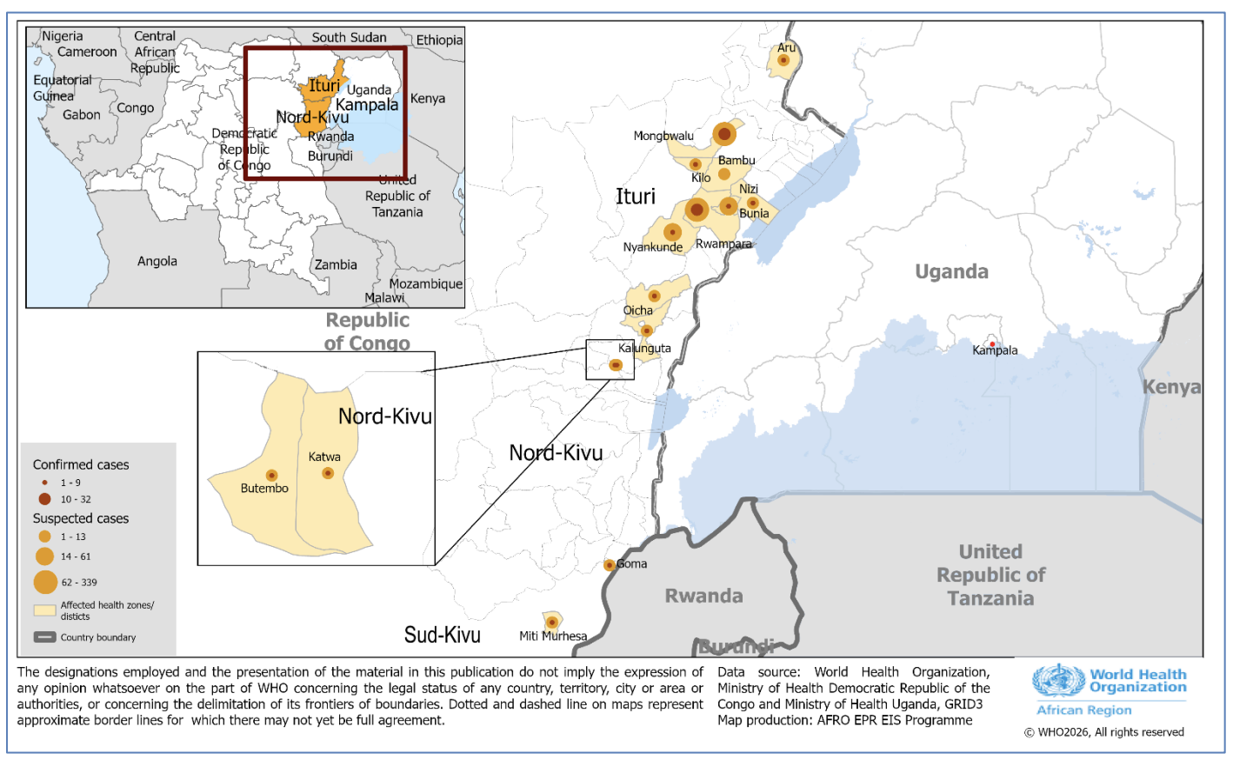
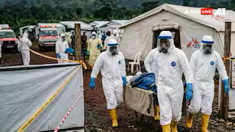
Epidemic of Ebola Disease - The Democratic Republic of the Congo and Uganda
HIGH PRIORITY
Epidemiological Trend
The current Ebola outbreak shows a localized but gradually increasing transmission trend within affected areas of Central Africa, particularly DRC and bordering regions of Uganda.
As of 24 May 2026, the DRC recorded 906 suspected cases and 223 suspected deaths. Among the 295 samples tested, 105 cases were laboratory confirmed, including 10 deaths. Confirmed cases were identified across 13 health zones: seven in Ituri Province, five in North Kivu Province, and one in South Kivu Province.
As of 24 May, Uganda had reported seven confirmed cases, up from two previously, while the number of confirmed deaths remained at one. All confirmed cases were reported in Kampala.
Case numbers have fluctuated with periodic spikes linked to delayed case detection and movement between remote communities.
Regional Impact
There are no confirmed cases reported in the Caribbean to date.
Figure 1: Distribution of suspected and confirmed Bundibugyo virus disease cases in the DRC and Uganda, as of 24 May 2026. Source: WHO Weekly External Situation Report 02, Data as of 24 May 2026
Source: WHO Disease Outbreak News, May 17, 2026 and WHO, Situation Report, May 24, 2026.

Slide 5

Response Priorities & Recommendations
CARPHA Immediate Actions
Ongoing Monitoring
Ebola watching Brief with public health actions.
Reactivated enhanced risk-based travel screening activated with IMPACS using the Advanced Passenger Information System (APIS) to identify travellers from Ebola-affected areas.
Close coordination with regional and international partners (WHO, PAHO, CDC, UKHSA, CDEMA, GOARN) to ensure timely information sharing and harmonised response actions.
Strengthening of confidential visitor-based surveillance systems across the region.
Monitoring outbreak through integrated early warning systems, including the Talkwalker social listening and regional surveillance platforms (THiS, CVSS, DHIS-2) to support rapid detection and situational awareness. Strengthened traveller and vessel surveillance systems across the Caribbean support early identification of potential importation risks, with rapid confidential alerts to Ministries of Health for immediate follow-up.
Media Coverage
Global media coverage focused on Central Africa, highlighting case counts, healthcare system strain, and international response efforts
Narratives stress preparedness and monitoring rather than global risk for spread.

Slide 6

Additional Threats Under Monitoring
Andes Hantavirus Cluster on Cruise Ship - Argentina
Norovirus Outbreak Outbreak
on Cruise Ship - France
The outbreak remains limited in scale and is primarily associated with post-exposure diagnosis among passengers, rather than ongoing community spread.
No secondary outbreaks have been detected, and global health authorities continue to classify the event as low risk for wider transmission.
Enhanced surveillance and contact tracing are ongoing through international maritime and public health networks to ensure early detection of any further travel-related cases.
The identification of additional cases after former passengers and crew have returned to their home country is expected given the long incubation period of Andes hantavirus and the possibility that some infections occurred on board the ship.
The outbreak has been rapidly contained through isolation measures, enhanced sanitation, and onboard infection control protocols, with no evidence of sustained spread after disembarkation.
There is no indication of international community transmission, and the event is considered a localized, short-duration cruise-associated cluster under routine surveillance.
Source: WHO Disease Outbreak News, May 13, 2026; EuroNews, May 13, 2026 and ECDC, Andes hantavirus outbreak in cruise ship, May 26, 2026.

